Slide 1
COVID-19 Detection from Chest X-Ray using CNN
By:
Ashim Baral (076BCT011)
Bibek Shrestha (076BCT014)
Bikal Devkota (076BCT017)

Slide 2
Agenda
Introduction
Methodology Used
Data Collection and Preprocessing
CNN Model Architecture
Model Evaluation
Real-world application
Conclusion

Slide 3
Aim
Develop a software for :
Identifying covid patients based on their Chest X-ray,
Monitoring respiratory health.
Objectives
Detect COVID-19 within short span of time.
Make identification of COVID-19 easy in rural areas where professional health official is not available.
Identify healthy patient, COVID-19 patients, and non-COVID Pneumonia.

Slide 4
Technologies Used
Software
Model Development | Website Development
Python TensorFlow NumPy Pandas Matplotlib Scikit-Learn OpenCV | Angular JavaScript HTML CSS

Slide 5
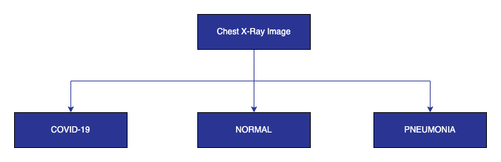
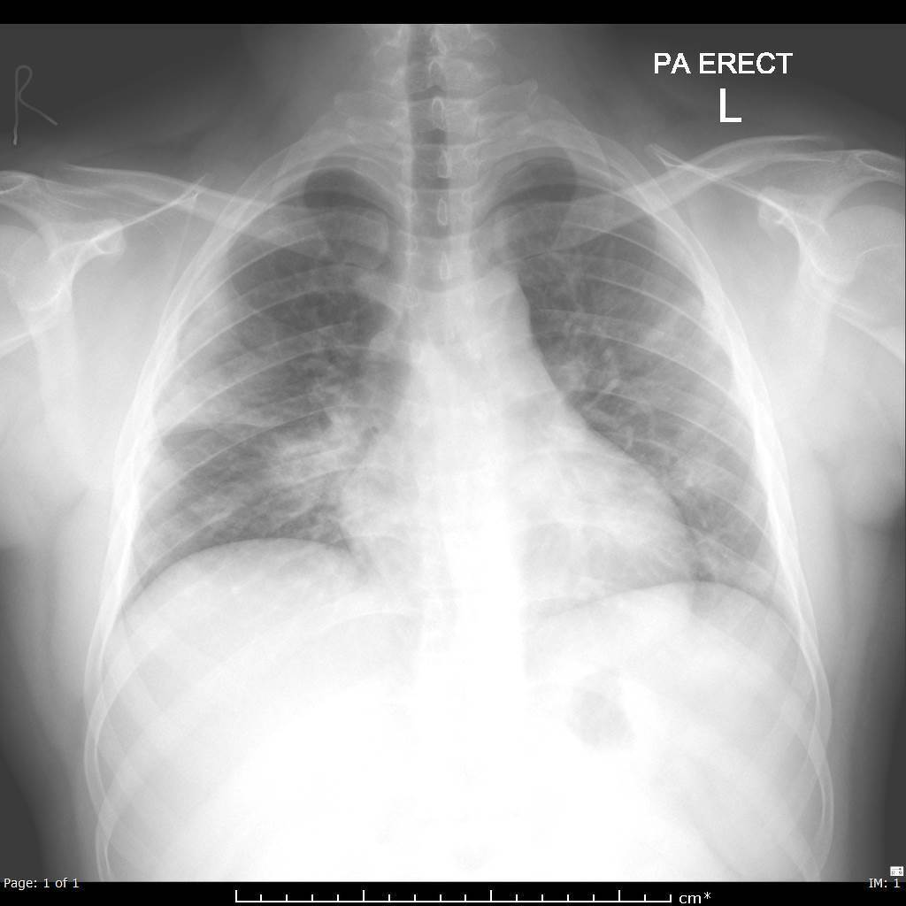
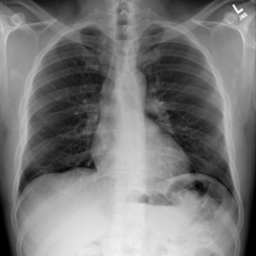
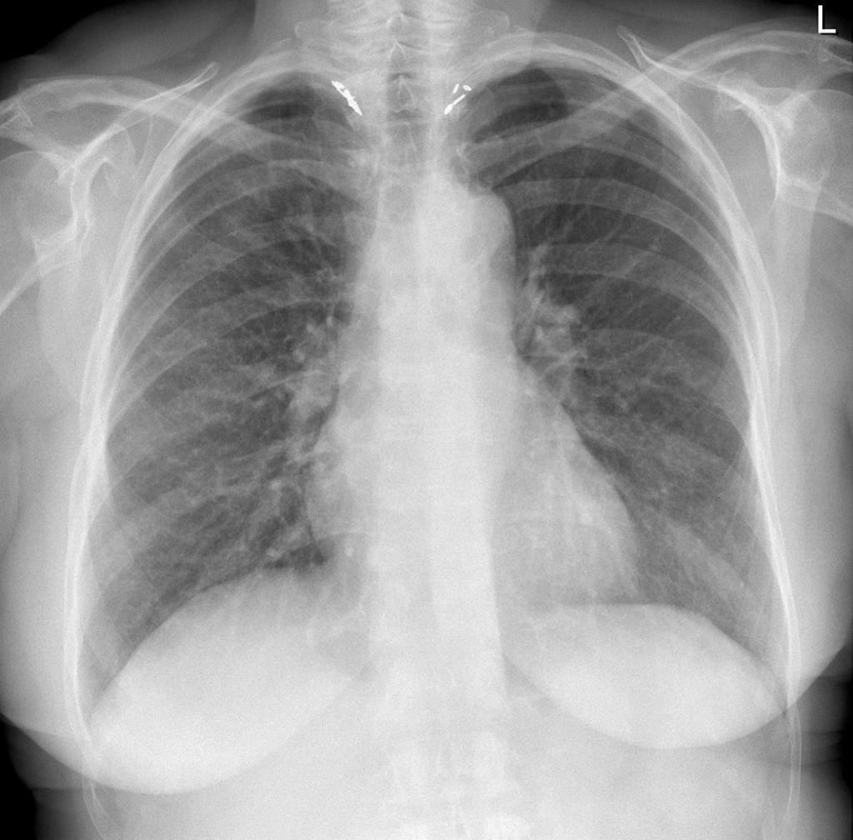
Classifying the Chest X-Rays

Slide 6
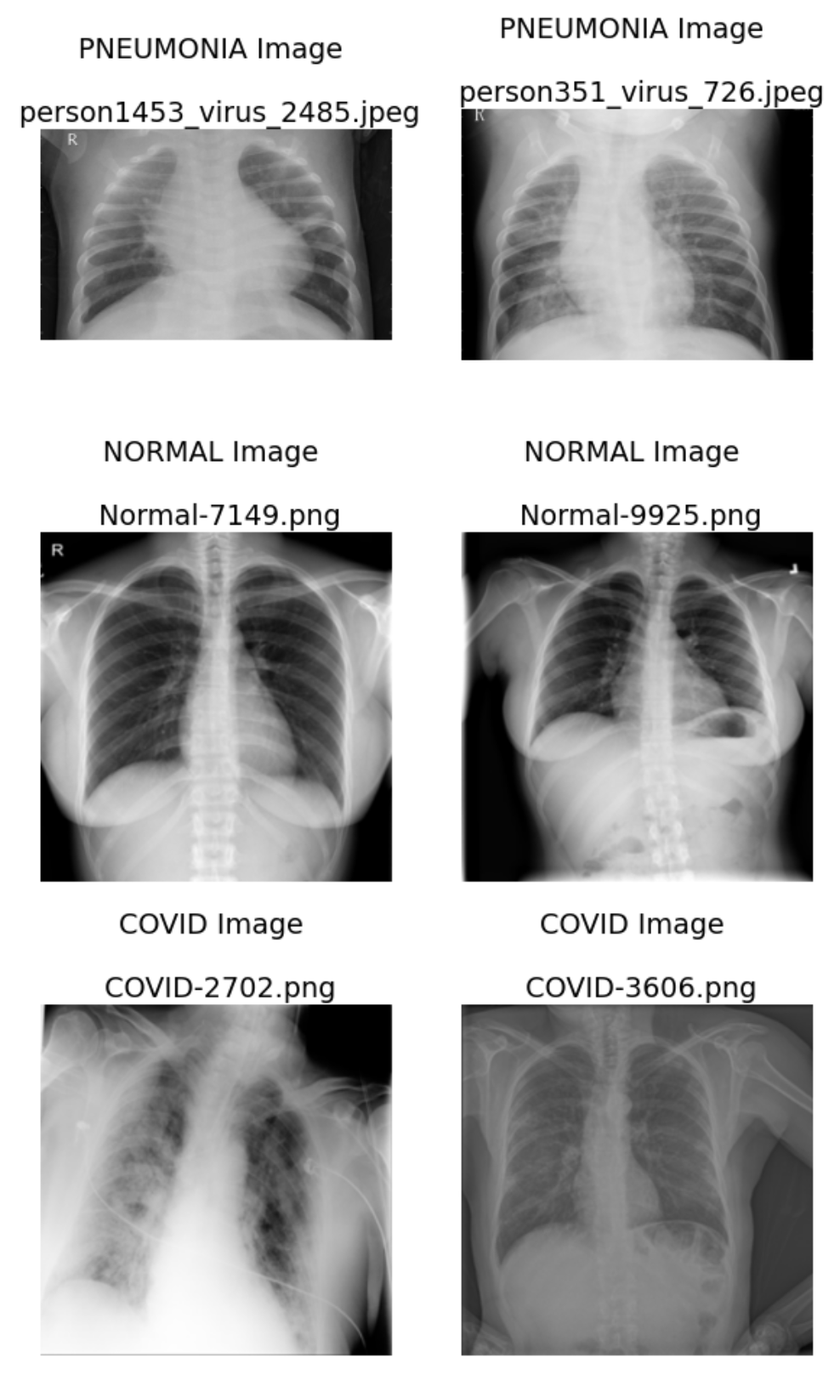
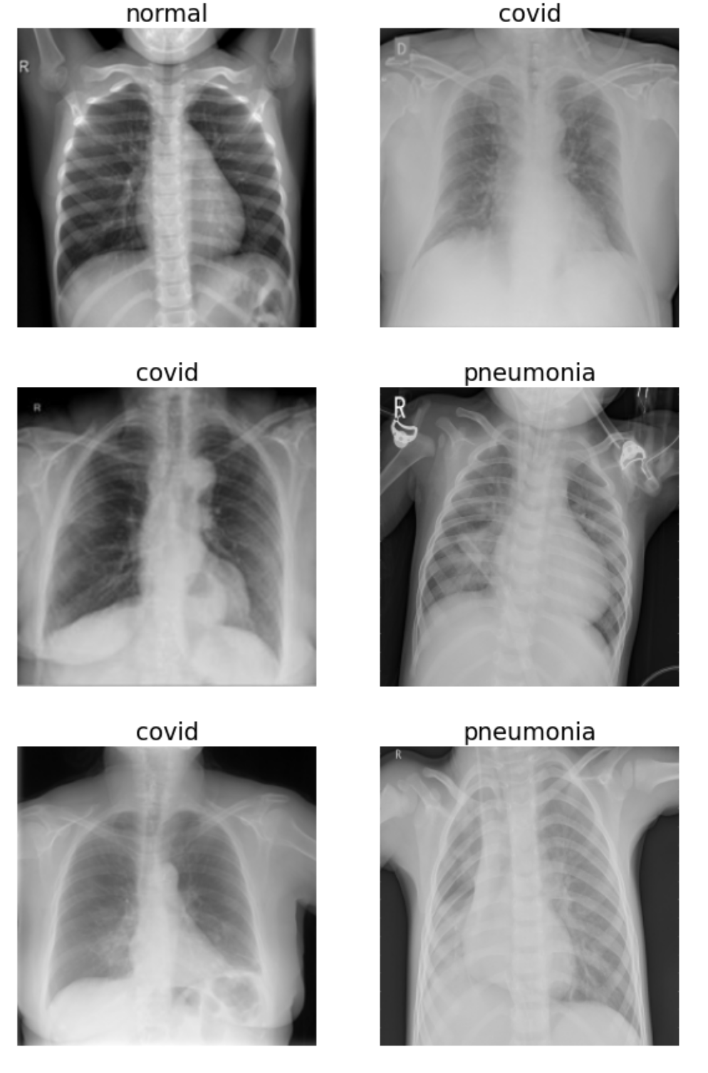
Data Preprocessing I
Step 1: Chest X-Ray images of Covid-19, Pneumonia, and Normal
Step 2: Color space conversion of an image
Step 3: Resize of images
Step 4: Normalization of data (Images)
Step 5: Data Augmentation

Slide 7
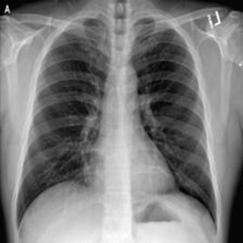
Data Preprocessing II
Image rotation using rotation_range
Image shifts using width_range _shift and height_shift_range
Image flips using horizontal_flip
Augmentation techniques applied on the images
Image Augmentation using ImageDataGenerator

Slide 8
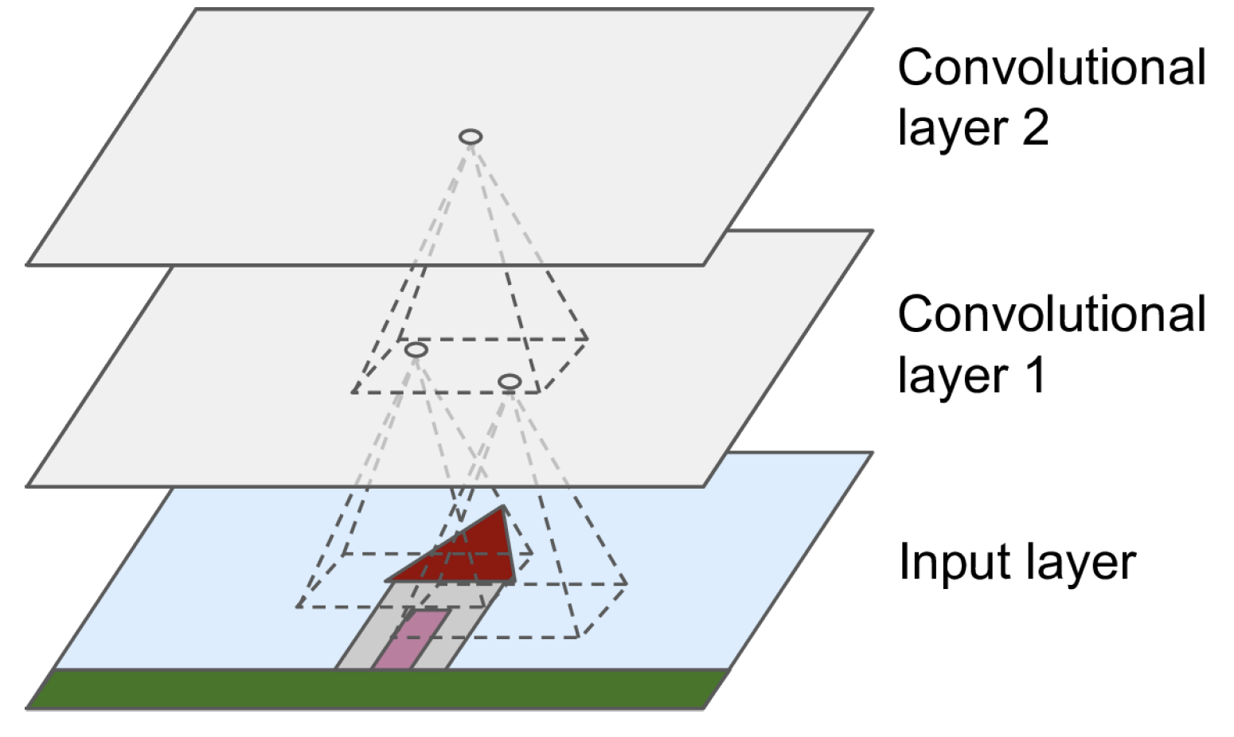
Convolutional Neural Network
CNN is a type of deep neural network
Mainly designed for image analysis or to process the pixel data
Made up of three layers: convolution, pooling, and fully connected layer
First two convolutional, and pooling layer is used to extract the features

Slide 9
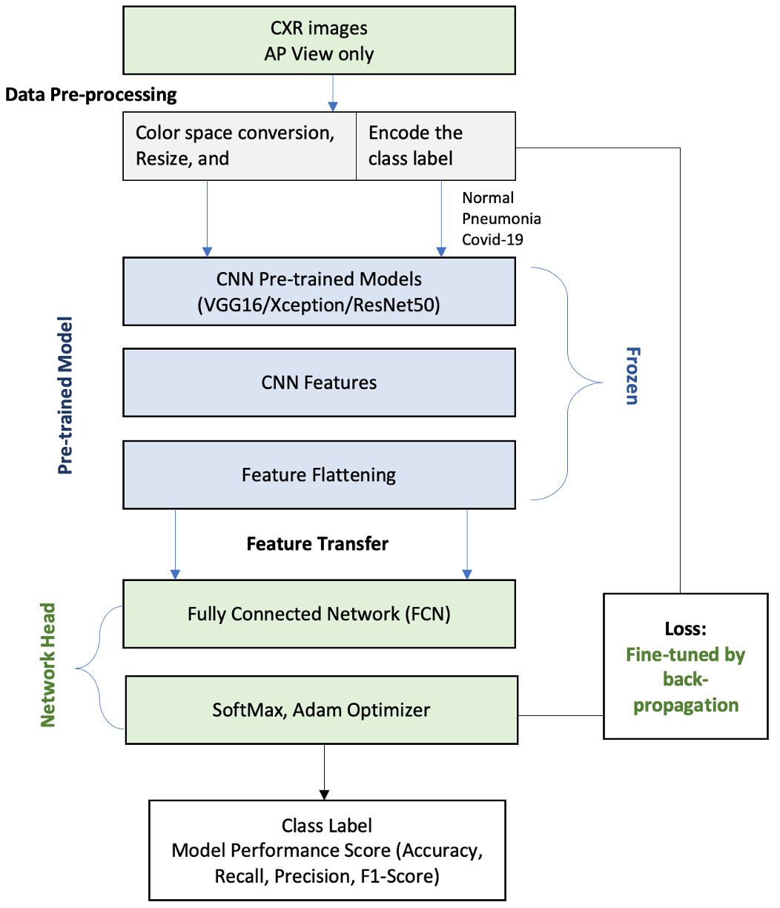
Architecture – Transfer Learning using the pre-trained models: VGG-16, ResNet50, and Xception
VGG-16
Classical architecture consisting of 13 convolution layers, 5 max-pooling layers, and 3 dense layers, but only 16 weight layers
Image size set as 224x224, standard input size for VGG-16 network
Xception
A deep convolutional neural network architecture that involves Depthwise Separable Convolutions
Starts with 2 regular convolutional layers, but then the rest of the architecture uses only separable convolutions (34 in all), plus a few max pooling layers and the usual final layers.
ResNet50
Core idea of ResNet is introducing a so-called “identity shortcut connection” that skips one or more layers
Uses 50 layer plain network architecture in which then the shortcut connection is added-

Slide 10
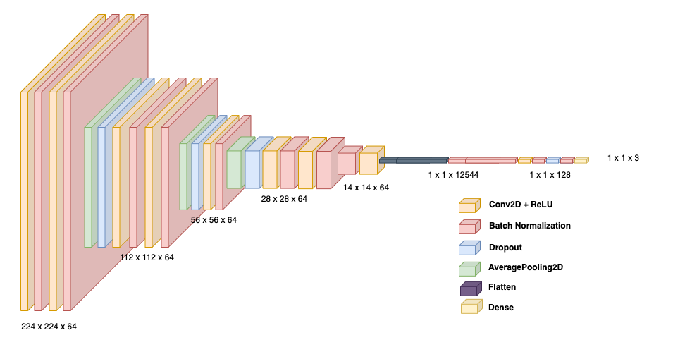
Custom CNN Architecture

Slide 11
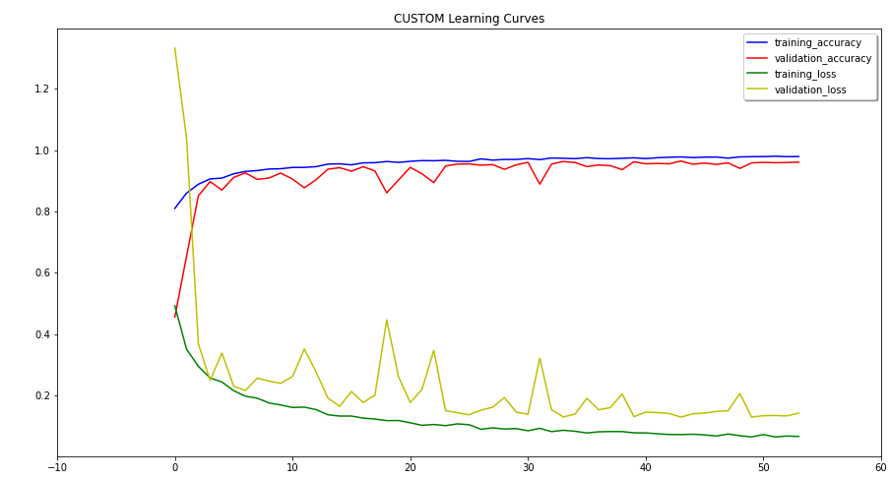
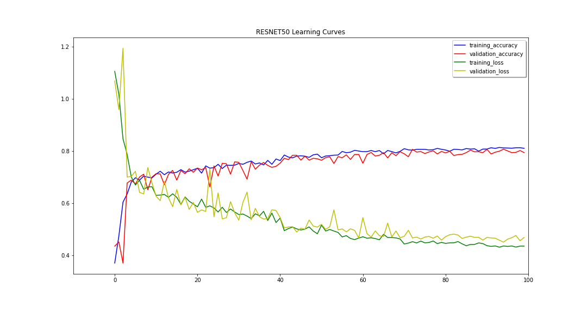
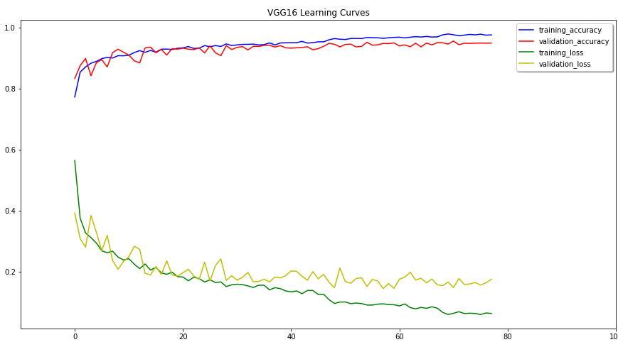
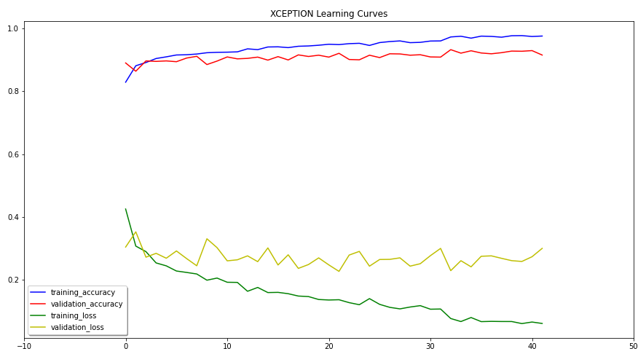
Model Evaluation
Custom CNN Learning Curve
ResNet50 Learning Curve
VGG-16 Learning Curve
Xception Learning Curve

Slide 12
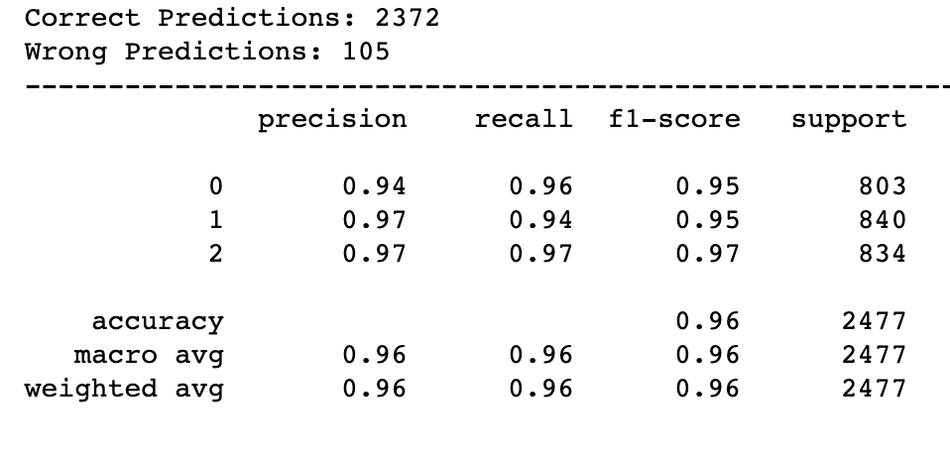
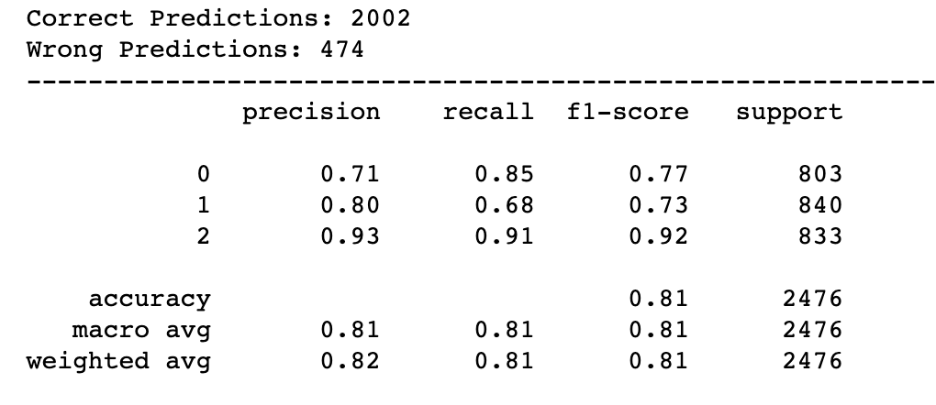
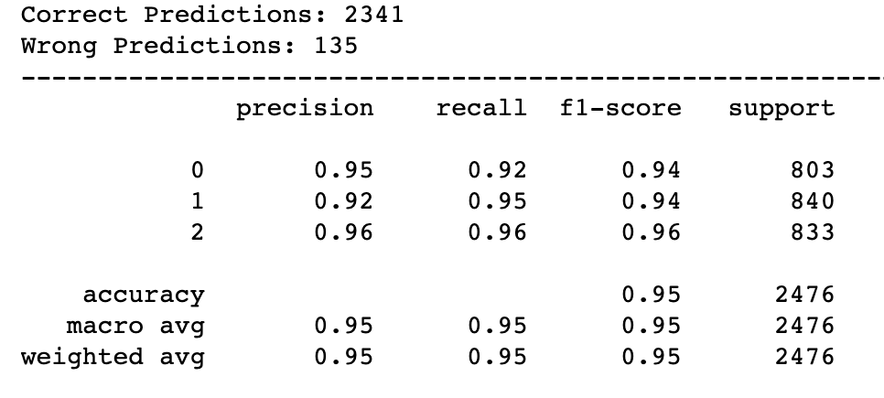
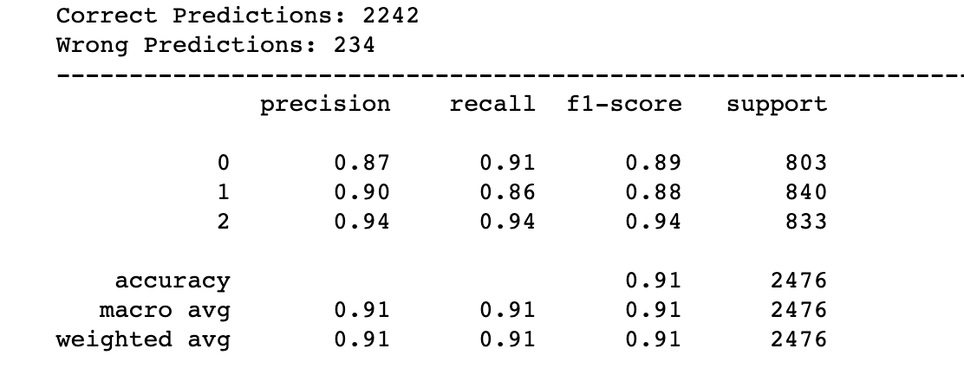
Model Evaluation II
Custom CNN Classification Report
ResNet50 Classification Report
VGG-16 Classification Report
Xception Classification Report

Slide 13
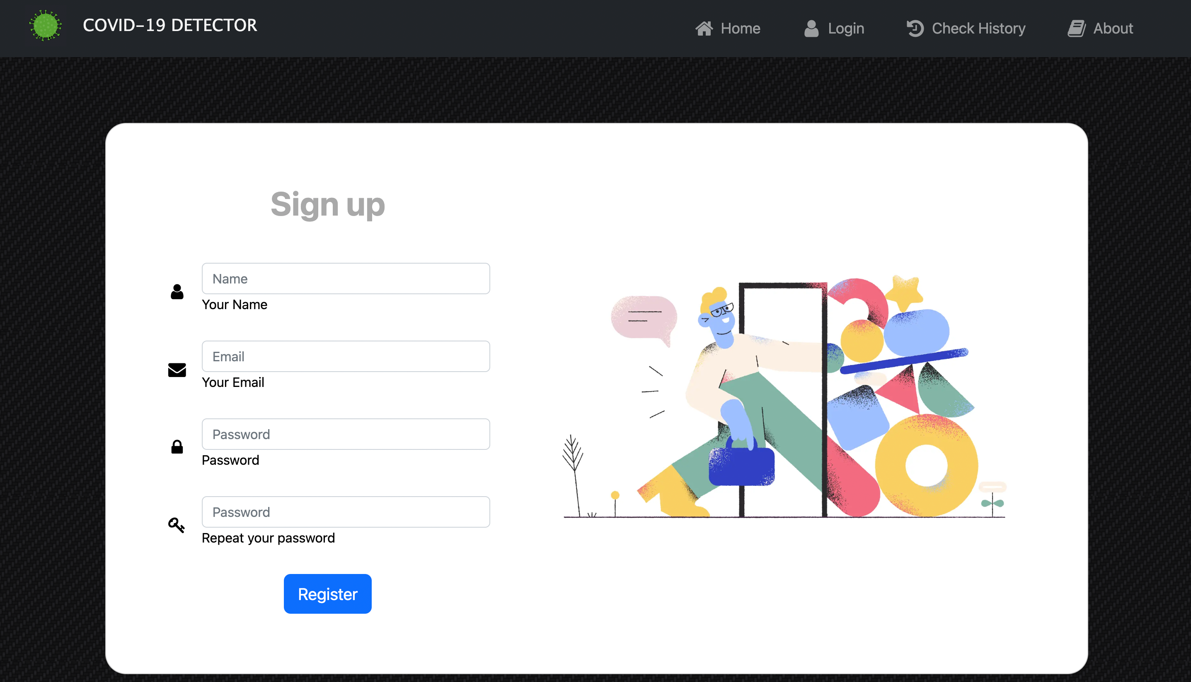
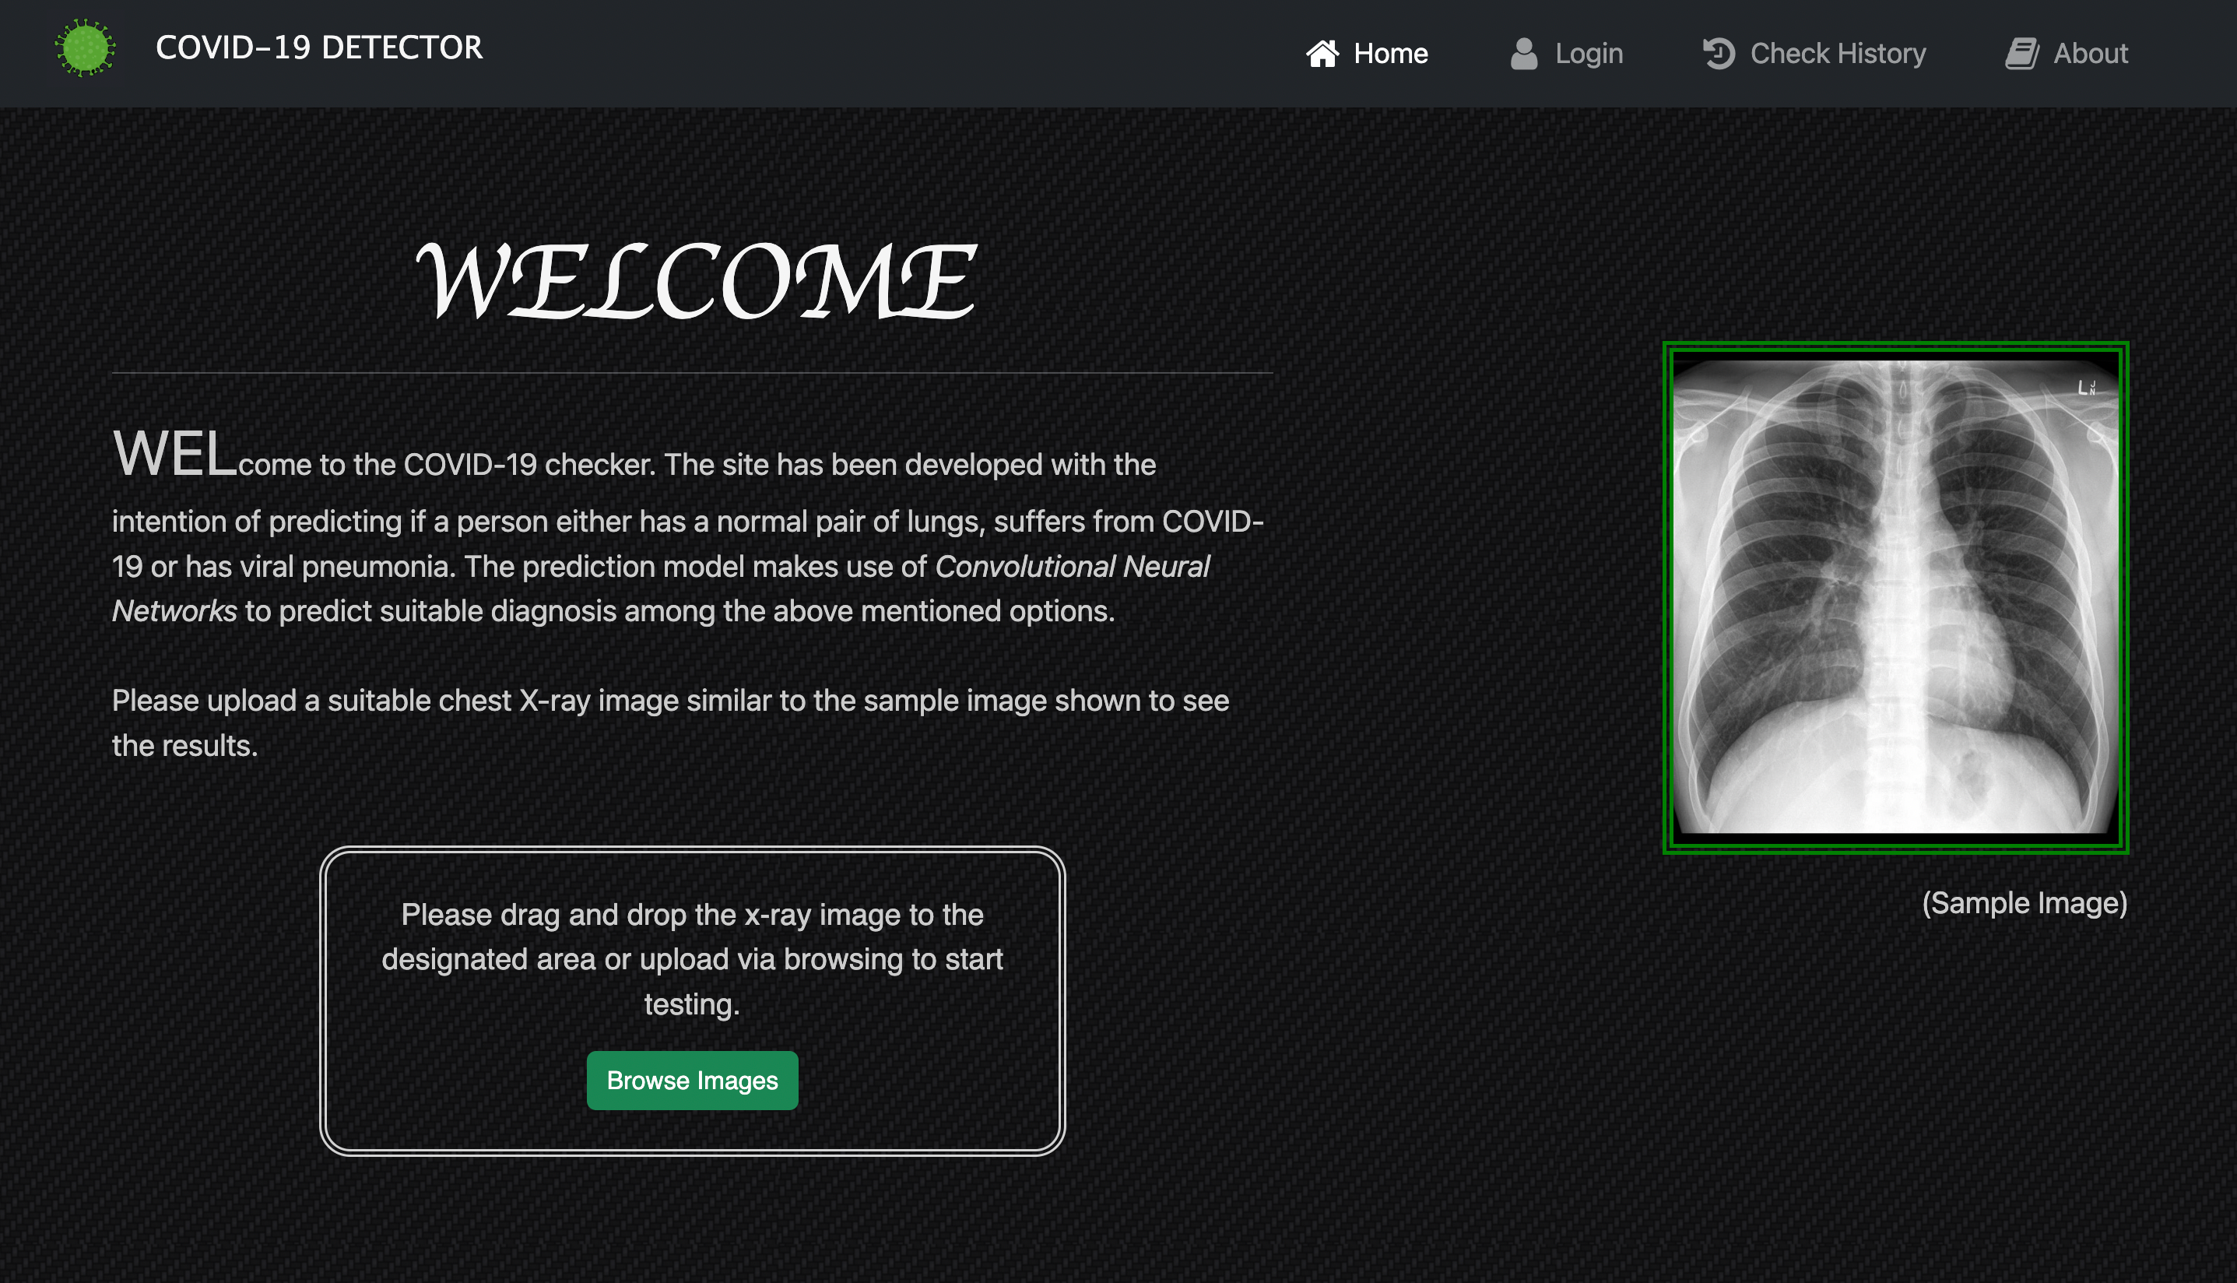
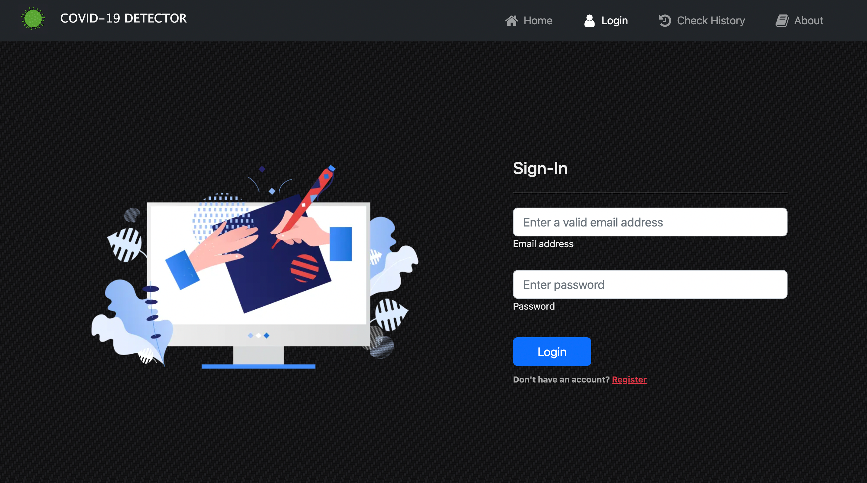
FrontEnd Snapshots

Slide 14
Real-world application
Early identification of COVID-19 patients
Prioritization of patients for testing or treatment
Diagnosis of patients remotely
Analysis of large datasets for epidemiological studies
Screening for potential cases at airports and borders.

Slide 15
Summary
Developed web application which categories Chest X-Ray images into three categories
Processed image using various preprocessing techniques
Trained different models and compared them using various performance metrics
Future Enhancements
Real-time Chest X-Ray image Scan, analysis, and prediction
Make Machine Learning Pipeline for the trained model with continual learning
Deploy trained model into mobile application.

Slide 16
THANK YOU!!!

